Slide 1


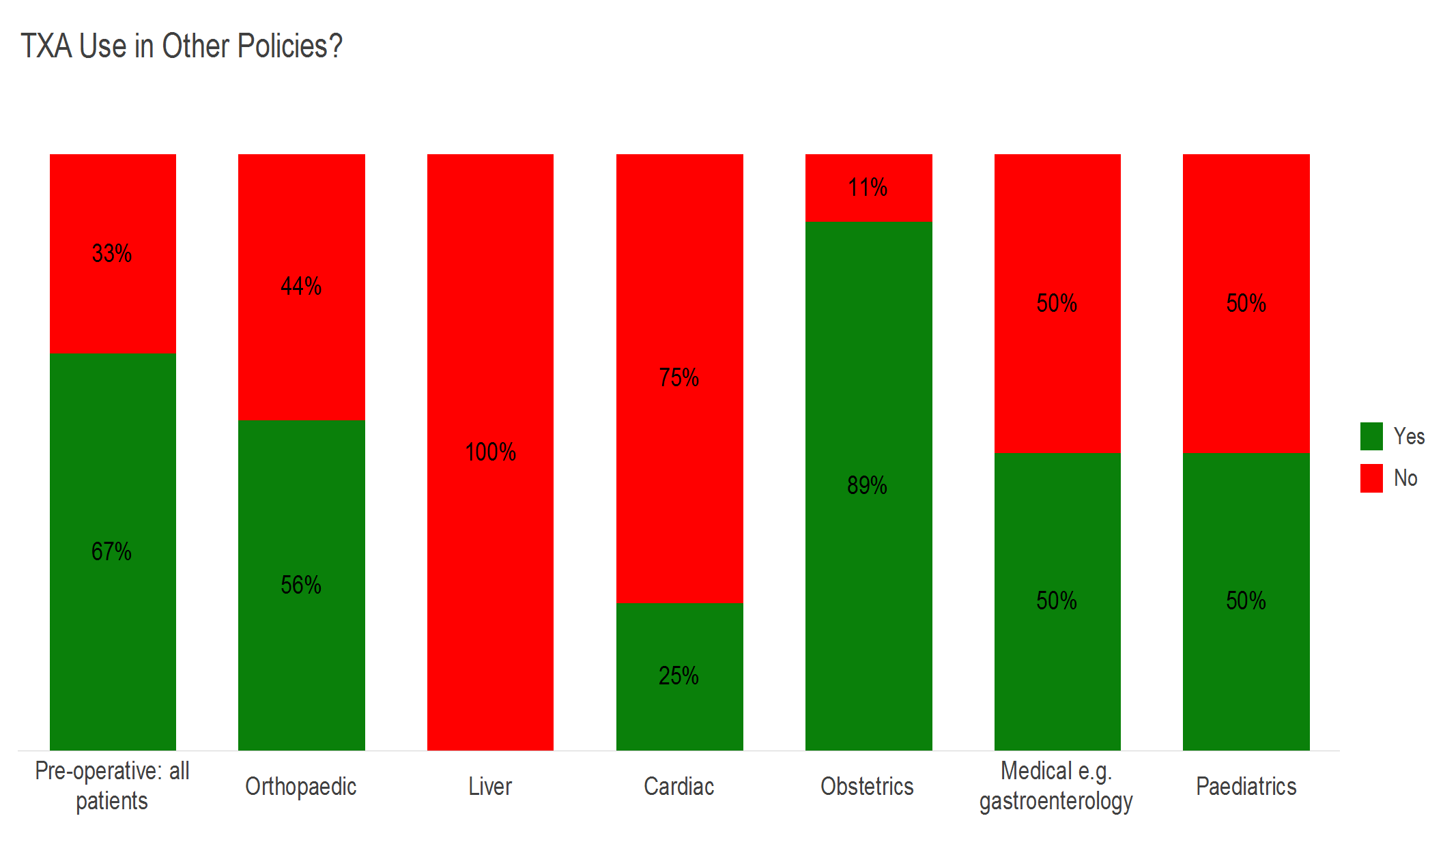
Survey of Tranexamic acid (TXA) use in the West Midlands region following key recommendations from the National Institute for Health and Care Excellence (NICE) Guidelines (NG24)
Sherwood A ¹, Hockley B ¹, Baker C ², Buchan J ³, Jackson J ⁴, Lim C ¹, Tuckwell C ⁵, Wood K ⁶, Taylor C ⁵, Morton S^{1,7}
¹ NHS Blood and Transplant Birmingham, ² University Hospital North Midlands, ³ Burton Hospitals NHS Foundation Trust, ⁴ Birmingham Women's and Children's NHS Foundation Trust, ⁵ Dudley Group NHS Foundation Trust, ⁶ Heart of England NHS Foundation Trust, ⁷University Hospitals Birmingham
Introduction
Recent NICE transfusion guidelines (NG24) include recommendations on TXA use for treatment of bleeding and as prophylaxis pre-operatively. We were interested to explore compliance with NICE guidelines in our region.
OTHER POLICIES
Method
The West Midlands Regional Transfusion Committee Audit Group formulated questions by an iterative process and conducted an online exercise using Snap Surveys© software; a paper option was also available.
Use of TXA in other policies
Results
MAJOR HAEMORRHAGE
48% (n=15) hospitals responded to the survey; 100% had a Major Haemorrhage Policy (MHP) in place. All MHPs had some recommendation on use of TXA.
CELL SALVAGE
73% hospitals have intraoperative cell salvage (IOCS) available; 82% can provide IOCS for all procedures. (This question was not appropriate for some trusts as types of surgery undertaken)
NICE Recommendation 1.1.7 [NG24; 2015]
Do not routinely use cell salvage without tranexamic acid.
TXA use was recommended in 67% of IOCS policies.
BLOOD LOSS SURGERY
NICE Recommendation 1.1.8 [NG24; 2015]
Consider intra‑operative cell salvage with tranexamic acid for patients who are expected to lose a very high volume of blood (for example in cardiac and complex vascular surgery, major obstetric procedures, and pelvic reconstruction and scoliosis surgery).
‘Have you changed, or are you planning to change any of your policies (with regards use of TXA based on the NG24 NICE guidelines)
Reasons for not fully implementing NICE recommendations
Counts Analysis % Respondents | Cardiac | Complex vascular surgery | Major obstetric procedures | Pelvic reconstruction | Scoliosis surgery
Total | 4 | 7 | 13 | 4 | 2
TXA in routine use | 2 50.0% | 2 28.6% | 6 46.2% | 3 75.0% | 2 100.0%
TXA in use in some cases | 2 50.0% | 1 14.3% | 5 38.5% | 1 25.0% | 1 50.0%
No TXA | - - | 4 57.1% | 2 15.4% | - - | - -
NICE Recommendation 1.1.5; 1.1.6 [NG24;2015]
Offer tranexamic acid to adults undergoing surgery who are expected to have at least moderate blood loss (greater than 500 ml).
Consider tranexamic acid for children undergoing surgery who are expected to have at least moderate blood loss (greater than 10% blood volume).
Respondents were asked if they had a policy which includes offering TXA to adults undergoing surgery who are expected to have at least moderate blood loss (>500ml)
Respondents were asked if they had a policy which includes offering TXA to children undergoing surgery who are expected to have at least moderate blood loss (>10%) blood volume as described by the NICE guideline.
CONTRAINDICATIONS
Respondents were asked what they consider to be contra-indications to TXA. Responses were:
“Excludes vascular patients who are heparinised intraoperatively. Caution in renal failure and pro-thrombotic tendencies
“…previous pulmonary embolus or other significant thrombotic episodes
“Allergy to TXA, haematuria, severe atherosclerosis - clearly all to be taken considering risks/benefits of giving TXA e.g. in life threatening haemorrhage
“Should not be given to patients known to have had thromboembolic events (e.g., deep vein thrombosis, pulmonary embolism, cerebral thrombosis, acute renal cortical necrosis, and central retinal artery and vein obstruction) please refer to manufactures guidance or pharmacy for further information
Counts Analysis % Respondents | Base | Policy which includes offering TXA to adults undergoing surgery
 |  | Yes | No | Do not treat adults
 | 15 100.0% | 8 53.3% | 6 40.0% | 1 6.7%
Conclusion
Good uptake of the NICE recommendations of those with a good evidence base, e. g. major haemorrhage.
Main barriers to compliance were:
Insufficient evidence to support current recommendations
Insufficient resource to implement change
Counts Analysis % Respondents | Base | Do you have any policy which includes offering TXA to children
 |  | Yes | No | Do not treat children
 | 15 100.0% | 5 33.3% | 6 40.0% | 4 26.7%
Reference
National Institute for Health and Care Excellence (NICE) (2015) Blood Transfusion NICE guideline [NG24]

