Slide 1
An introduction to JPAC
December 2023

Slide 2
What is JPAC?
Who is JPAC?
What does JPAC do?
How are JPAC guidelines updated?
Who else does JPAC work with?

Slide 3
What is JPAC?
History and current purpose

Slide 4
A brief history of JPAC
1987
UKBTS/NIBSC Joint Liaison Group formed to produce guidelines for the standardisation and safety of blood and products provided by UK Blood Services.
NIBSC: National Institute for Biological Standards and Control, now part of MHRA)
Three working groups are established.
1990
1st edition of the Red Book guidelines published.
1991
UKBTS/NIBSC working groups become Standing Advisory Committees (SACs).
Executive Group formed to coordinate between Liaison Group and SACs.

Slide 5
A brief history of JPAC
1992
UK Advisory Committee on Transfusion Transmitted Disease is brought into
UKBTS/NIBSC organisation as SAC on Transfusion Transmitted Infection (SACTTI).
2nd edition of the Red Book published.
2005
The Executive Group becomes the Executive Working Group (EWG). The previous
Liaison Group forms the overarching Joint Professional Advisory Committee (JPAC).
Today
JPAC has two distinct remits:
1. To be an advisory committee to the UK Blood Transfusion and Tissue Transplantation Services
2. To prepare detailed service guidelines for the UK Blood Transfusion and Tissue Transplantation Services

Slide 6
Who is JPAC?
Standing Advisory Committees and JPAC Office

Slide 7
JPAC Structure
Each Standing Advisory Committee (SAC) consists of a number of subject matter experts led by a Chair
Ryan
Evans
Blood
Components
SACBC
Angus
Wells
Care & Selection
of Donors
SACCSD
Megan
Rowley
Clinical
Transfusion Medicine
SACCTM
Nicole
Thornton
Immuno-haematology
SACIH
Position
vacant
Information Technology
SACIT
Akila Chandrasekar
Tissues & Cellular Therapy Products
SACTCTP
Heli
Harvala
Transfusion Transmitted Infection
SACTTI

Slide 8
JPAC Structure
Stephen Thomas
Professional Director
Pete Rae
Scientific Publishing Manager
Gary Mallinson
Scientific Lead Safety Policy
Anna Witham
Administrator
EWG
Executive Working Group
The SAC Chairs, along with the JPAC Office, form the Executive Working Group (EWG)
JPAC Office
SACBC
SACCSD
SACCTM
SACIH
SACIT
SACTCTP
SACTTI

Slide 9
JPAC Structure
Regulators
Members
MHRA
Medicines & Healthcare
products Regulatory Agency
UK Medical Directors
NHSBT, SNBTS, WBS & NIBTS
MHRA South Mimms Laboratories
formerly National Institute for Biological Standards and Control
HTA
Human Tissue Authority
The EWG, together with the Medical Directors of the Blood Services and representatives from other external stakeholders, form JPAC
UKQM
UK Quality Managers Group
JPAC
Joint Professional Advisory Committee
Observers
SaBTO
Advisory Committee on the
Safety of Blood, Tissues & Organs
EWG
Executive Working Group
JPAC Office
Medical Director of IBTS
Irish Blood Transfusion Service
SACBC
SACCSD
SACCTM
SACIH
SACIT
SACTCTP
SACTTI

Slide 10
JPAC Structure
UK Forum
JPAC reports to the UK Forum, comprised of Chief Executive and Medical Director of each service
JPAC
Joint Professional Advisory Committee
EWG
Executive Working Group
JPAC Office
SACBC
SACCSD
SACCTM
SACIH
SACIT
SACTCTP
SACTTI

Slide 11
What does JPAC do?
“… prepare detailed service guidelines…”

Slide 12
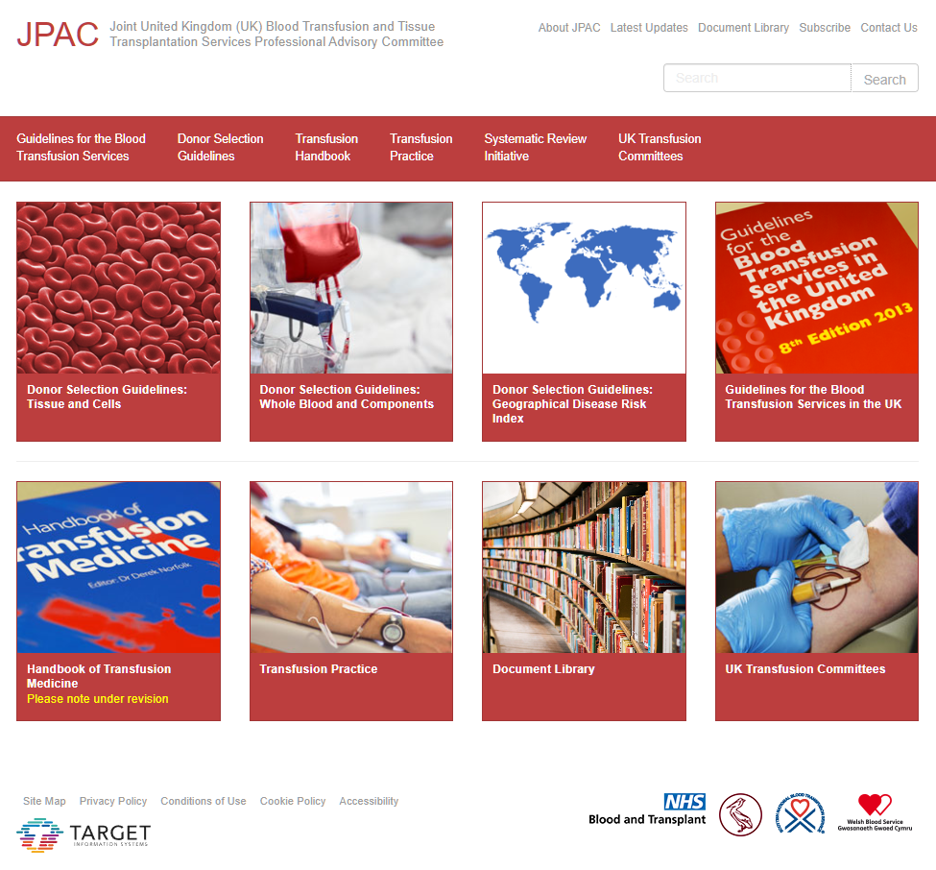
JPAC's guidelines
Donor Selection Guidelines (DSG)
Guidelines for the Blood Transfusion Services in the UK (Red Book)
Risk Assessments & Position Statements
JPAC's guidelines are considered best practice
Individual Blood Services are responsible for implementation and may choose to adopt different processes
All available at www.transfusionguidelines.org

Slide 13
Donor Selection Guidelines
Used to assess donor eligibility
Accessible via website (live) and PDF versions (offline)
Currently six individual DSGs
BM-DSG
Bone Marrow
& Peripheral Blood Stem Cell
CB-DSG
Cord Blood
TD-DSG
Tissue – Deceased Donors
TL-DSG
Tissue –
Live Donors
WB-DSG
Whole Blood & Components
GDRI
Geographic Disease
Risk Index

Slide 14
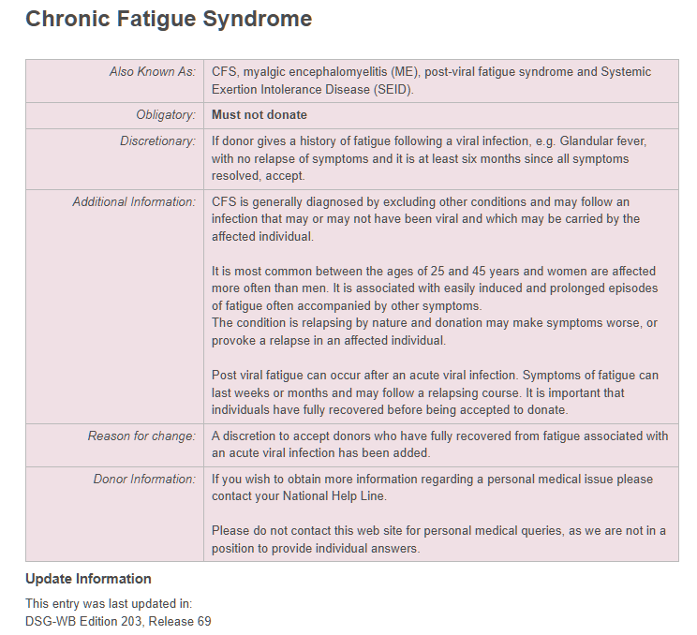
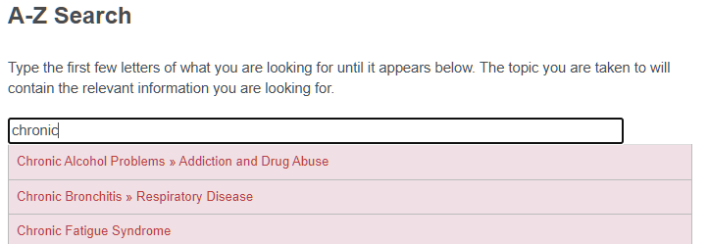
Donor Selection Guidelines
A-Z search
Similar format across DSGs
Reason for last change indicated

Slide 15
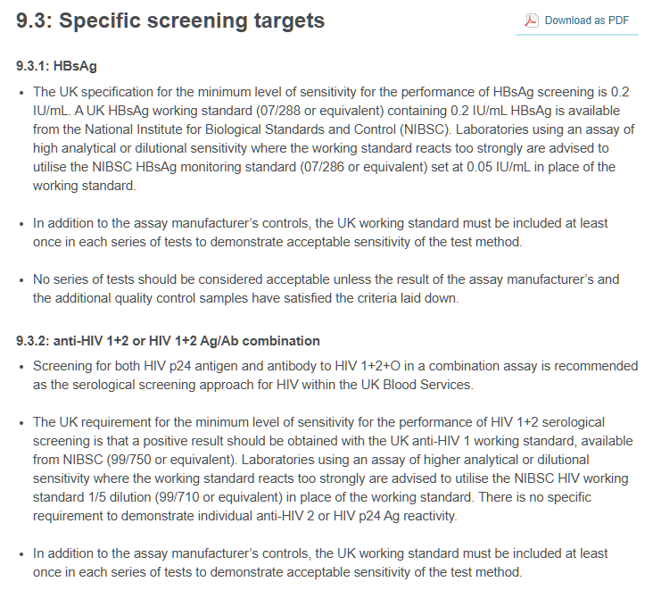
Red Book
Guidelines for all materials produced for therapeutic and diagnostic use
Covers donor care, donation premises, collection procedures, testing requirements and product specifications

Slide 16
Red Book
Last hard copy was 8th Edition
Red Book will now be online only with rolling updates as needed
Most chapters have now been updated from their 2013 versions
A new website is planned for both Red Book and DSGs

Slide 17
Risk Assessments & Position Statements
Risk assessments of Transfusion Transmissible Infectious agents are carried out by SACTTI on a rolling basis
2-3y review period or whenever a significant change is identified
Risk assessments are used to write Position Statements which are published on the JPAC website
Updated Position Statements may then facilitate necessary revisions to the Donor Selection Guidelines or the Red Book

Slide 18
Current Risk Assessments
Babesia
Borrelia burgdorferi (Lyme Disease)
Chikungunya Virus
Crimean-Congo Haemorrhagic Fever (CCHF)
Dengue Virus
Ebola
H5N1 Pandemic Influenza
Hepatitis A (HAV)
Hepatitis E (HEV)
Human Herpesvirus 8 (HHV-8)
Human Parvovirus PARV 4 (previously B19)
Lymphocytic Choriomeningitis Virus (LCMV)
Leishmania
Middle East Respiratory Syndrome Coronavirus (MERS-CoV)
Mpox (formerly Monkeypox)
Seasonal Influenza A (Non Pandemic)
Severe Acute Respiratory Syndrome Coronavirus (SARS-CoV-1)
Severe Acute Respiratory Syndrome Coronavirus (SARS-CoV-2)
Simian Foamy Virus (SFV)
Tick-Borne Encephalitis Virus (TBEV)
Toxoplasmosis
Usutu Virus (USU)
Variant Creutzfeldt-Jakob Disease (vCJD)
Xenotropic Murine Leukaemia Related Virus (XMRV)
Yellow Fever
Zika Virus

Slide 19
Current Position Statements
Arrangements in place for monitoring threats to the UK blood supply from new and emerging infections
Blood donor selection to minimise risk of transfusion transmissible infectious agents entering the blood supply
Calcium Abnormalities and Apheresis Donation
Chikungunya Virus
COVID-19 Vaccines and Blood Transfusion (including Pre-deposit Autologous and Directed Donations)
Dengue
Ebola
The estimated residual risk that a donation made in the infectious window period is not detected on testing: risks specific for HBV, HCV and HIV in the UK, 2020-2022
Granulocyte Therapy
Guidance for the addition and removal of an infectious disease risk entry in the GDRI
Horizon Scanning - Management Process Description
Human Herpesvirus-8
Methylene Blue-Treated Plasma
Mpox
Perfluoroalkyl and polyfluoroalkyl substances (PFAS)
SARS-CoV-2 and the Safety of Blood, Tissues and Stem Cells
vCJD
West Nile Virus
X-ray irradiation of blood components
Zika Virus

Slide 20
How are JPAC guidelines updated?
Approval of changes and publication

Slide 21
Approval process
Change
request
SAC
A change is discussed by a SAC

Slide 22
Approval process
Change
request
SAC
EWG
More significant changes
are discussed by EWG

Slide 23
Approval process
Change approved
JPAC Director
Change
request
SAC
EWG
Publication
For minor changes (e.g. outbreak dates in the GDRI) the JPAC Director can approve publication

Slide 24
Approval process
Change approved
JPAC Director
Change
request
SAC
EWG
Publication
Change approved
EWG can approve the publication for changes that do not need full JPAC approval (e.g. updated Position Statements, minor changes to DSG entries)

Slide 25
Approval process
Change approved
JPAC Director
Change
request
SAC
EWG
JPAC
Change
approved
Publication
Change approved
The most significant change requests are discussed and approved by JPAC
Six EWG and three JPAC meetings per year

Slide 26
Publication
Change Notification (CN)
prepared by JPAC Office and approved by SAC Chair
Pre-publication
CN distributed to Blood Services
Quality Assurance departments perform gap analysis, provide feedback, and plan for implementation
Go live
on the date of publication

Slide 27
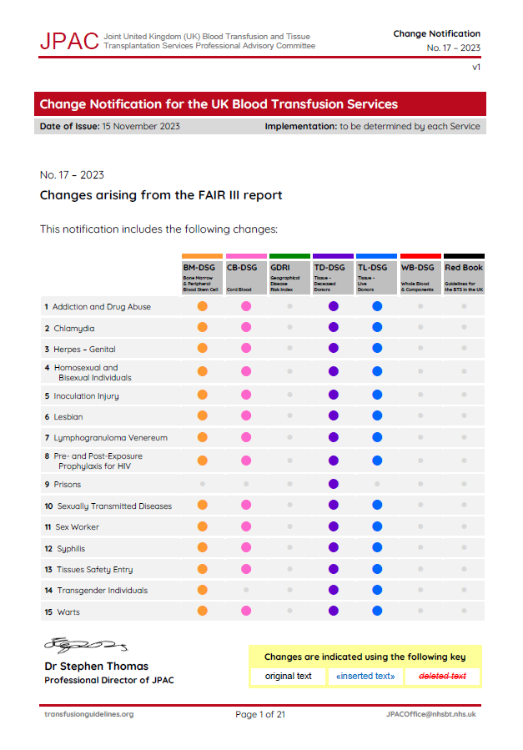
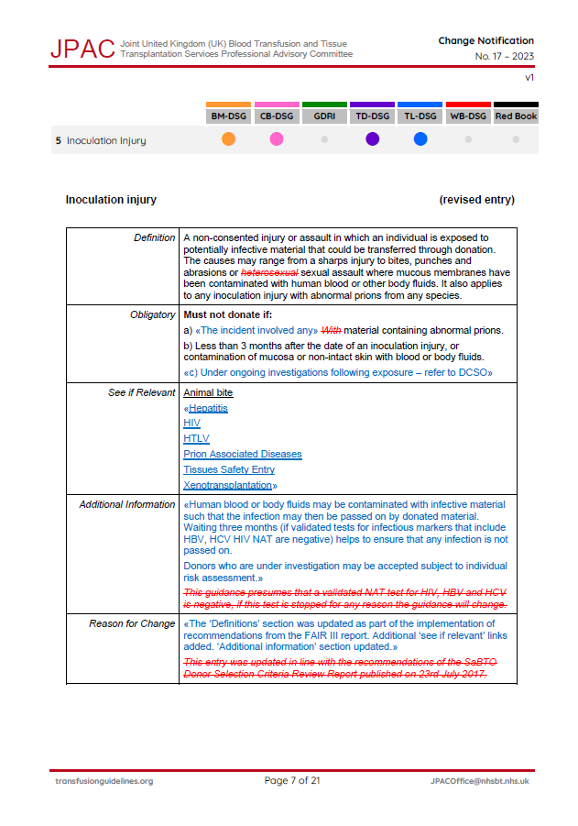
Change Notification
Highlights changes to text
Current text
«New text»
Removed text
Which guidelines apply
Date of publication

Slide 28
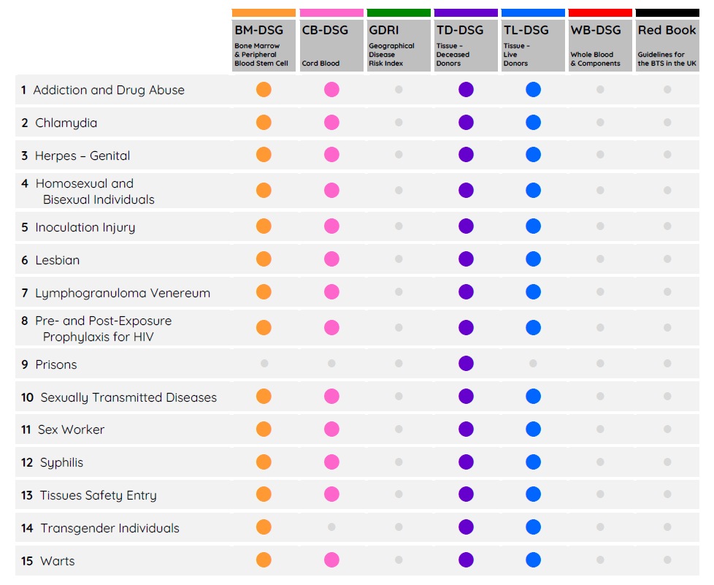
Change Notification
Highlights changes to text
Current text
«New text»
Removed text
Which guidelines apply
Date of publication
One CN can include several relevant DSG or Red Book changes

Slide 29
Change Notification
Publication date is agreed between SAC Chair and JPAC Office
Important to consider urgency v reasonable notice for:
Updated materials
Re-training of staff
Implementation plans
Notice period varies according to nature of changes
Urgent changes
1-2 weeks
Most changes
4 weeks
Significant changes
6-12 weeks

Slide 30
Who else does JPAC work with?
Collaboration with SaBTO

Slide 31
Work with SaBTO
(Advisory Committee on the Safety of Blood, Tissues and Organs)
Aim to collaborate where required and avoid duplication of work
Scientific Lead Safety Policy is joint JPAC/SaBTO role fostering communication and inclusion of SACs in SaBTO working groups
Joint meeting of the JPAC and SaBTO secretariats now held quarterly to discuss areas of mutual interest, from June 2023

Slide 32
Work with SaBTO
(Advisory Committee on the Safety of Blood, Tissues and Organs)
Remit of SaBTO
Remit of JPAC
Areas of shared interest between SaBTO and JPAC
Consider the most appropriate ways to ensure the safety of blood, cells, tissues and organs used for transfusion and transplantation.
Be responsible for the detailed guidelines for the UK Blood Transfusion and Tissue Transplantation Services, produced as the Red Book
Advise Health Ministers in England, Wales, Scotland and Northern Ireland; the UK Health Departments; the UK Blood services and Transplant service, and the NHS more widely.
Be an Advisory Committee to the UK Blood Transfusion and Tissue Transplantation Services.
Monitor EU Directives and UK legislation on blood, cells, tissues and organs in conjunction with the relevant competent authorities to ensure committees' guidance is, where appropriate, consistent with the directives.
Take account of regulatory frameworks, e.g. European Union and the UK Blood Safety and Quality Regulations (BSQR).

Slide 33
Thank you
JPACOffice@nhsbt.nhs.uk

