Slide 1
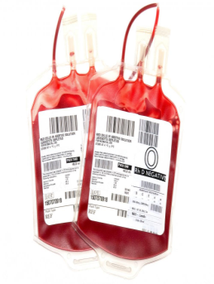
Gaining Informed Transfusion Consent
COMMUNICATE - Describe why patient might need a transfusion
OBJECTIONS –Promote active participation in the discussion. Give information on risks, benefits and alternatives to Transfusion
NOTIFY – All relevant staff
SAFETY - Mention inability to donate after Transfusion, donor screening and the risks associated with transfusion (inc. VCJD)
EXPLAIN - The Transfusion information to the patient and give patient information leaflets on Blood Transfusion
NOTES –Document in patient notes with Date/Time/Signature of Clinician before Blood Transfusion commences
TRANSFUSE - Only when the above key steps have been performed

Slide 2
GAINING INFORMED TRANSFUSION CONSENT
COMMUNICATE – Describe/Discuss why patient might need a transfusion
OBJECTIONS – Give information on risks, benefits and alternatives to Transfusion
NOTIFY – All relevant staff
SAFETY - Inform patient they cannot donate after Transfusion, donor screening and the risks associated with transfusion (inc. VCJD)
EXPLAIN - The Transfusion information to the patient and give patient information leaflets on Blood Transfusion
NOTES – Document in patient notes with Date/Time/Signature of Clinician before Blood Transfusion commences
TRANSFUSE - Only when the above key steps have been performed

