Slide 1
Alloantibodies and pregnancy
Lab Matters
26th June 2019
Tim Wreford-Bush – Transfusion Laboratory Manager
North Bristol NHS Trust

Slide 2
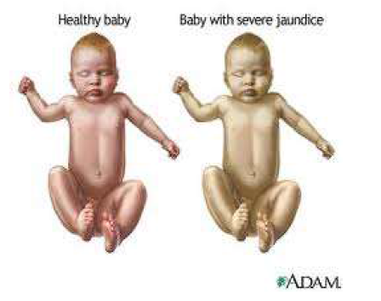
Alloantibodies and pregnancy

Slide 3
Alloantibodies and pregnancy
BCSH guidelines 2016
ABO and D typing
Red cell antibody screening/identification
Screening cells C,c,D,E,e,K,k,Fya,Fyb,Jka,Jkb,M,N,S,s,Lea
Homozygous expression of Rh, Fy, Jk, S antigens
Follow up tests

Slide 4
Alloantibodies and pregnancy
MAIN RECOMMENDATIONS
Sample labelling
ABO and D grouping
Antibody screens
Timing of tests
(early in pregnancy and again at 28/40)
Labs to keep records of anti-D administration

Slide 5
Alloantibodies and pregnancy
MAIN RECOMMENDATIONS
FMU referrals
Antibody Card
Post delivery testing of babies
Regular audit of practice

Slide 6
Alloantibodies and pregnancy
Clinically significant antibodies (IgG)
Anti-D
Anti-c
Anti-K
Anti-C
Anti-E
Anti-Fya
Anti-Jka
Other antibodies

Slide 7
Alloantibodies and pregnancy
Anti-D+C specificity
Possible anti-G
Demonstrated by disproportionately high titres of anti-C
ALWAYS refer to a reference lab as patients
with anti-G are still eligible for RAADP and post
delivery anti-D Ig

Slide 8
Alloantibodies and pregnancy
Techniques
        CAT
        Capture
        Tube
Paternal testing
Fetal genotyping
Referral to reference laboratory

Slide 9
Alloantibodies and pregnancy
Anti-D quantification (NIBSC 2003)
Differentiation between immune and prophylactic anti-D
Test every 4 weeks to 28/40 then
Test every 2 weeks to delivery
<4iu/ml HDN Unlikely
4-15iu/ml Moderate risk of HDN
>15iu/ml High risk of hydrops fetalis

Slide 10
Alloantibodies and pregnancy
Anti-c quantification (NIBSC 2003)
Test every 4 weeks to 28/40 then
Test every 2 weeks to delivery
<7.5iu/ml Continue to monitor
7.5-20iu/ml Risk of moderate HDN
>20iu/ml Risk of severe HDN

Slide 11
Alloantibodies and pregnancy
Anti-K titration
Anti-K often present as a result of previous
transfusion
Severity not correlated with antibody titre
Affected pregnancies usually titre of 32+
Paternal sample K negative

Slide 12
Alloantibodies and pregnancy
Other antibodies
Many other specificities
Repeat testing at 28/40
No further testing recommended
Medical decision regarding women with hx of HDN

Slide 13
Alloantibodies and pregnancy
Routine ante-natal anti-D prophylaxis (RAADP)
1500iu at 28/40 gestation
OR
500iu at 28/40 and again at 34/40

Slide 14
Alloantibodies and pregnancy
BCSH guidelines 2013
Administration of anti-D immunoglobulin for the prevention of HDFN
NICE guideline 2008
Routine antenatal anti-D prophylaxis for women who are rhesus D negative
RCOG guidelines 2011 (Archived)
The use of Anti-D for Rhesus (D) prophylaxis

Slide 15
Alloantibodies and pregnancy
ffDNA testing
16/40
Results dictate issue of RAADP

Slide 16
Alloantibodies and pregnancy
Potentially sensitising events
● Amniocentesis, chorionic villus biopsy and cordocentesis
● Ante-partum haemorrhage/vaginal bleeding in pregnancy
● External cephalic version
● Fall or abdominal trauma
● Ectopic pregnancy
● Evacuation of molar pregnancy
● Intrauterine death and stillbirth
● In utero therapeutic interventions (transfusion, surgery, insertion of shunts, laser)
● Miscarriage, threatened miscarriage
● Therapeutic termination of pregnancy
● Delivery – normal, instrumental or Caesarean section
● Intraoperative cell salvage

Slide 17
Alloantibodies and pregnancy
Miscarriage or painless PV bleeding at <12 weeks, no anti-D required unless surgical intervention
T.O.P./Ectopic pregnancy/Molar pregnancy need PAD
Any sensitising event after 12/40 gestation
regardless of whether RAADP has been given or is due to be given
Guidelines say at least 250iu
Between 12 – 20 weeks give 500iu
>20 weeks perform Kleihauer (or flow) and give at least 500iu

Slide 18
Alloantibodies and pregnancy
A CAUTIONARY TALE
Result at booking
PAD issued for use at 28/40
Result at 28/40
rr test
Delivery

